Slide 1
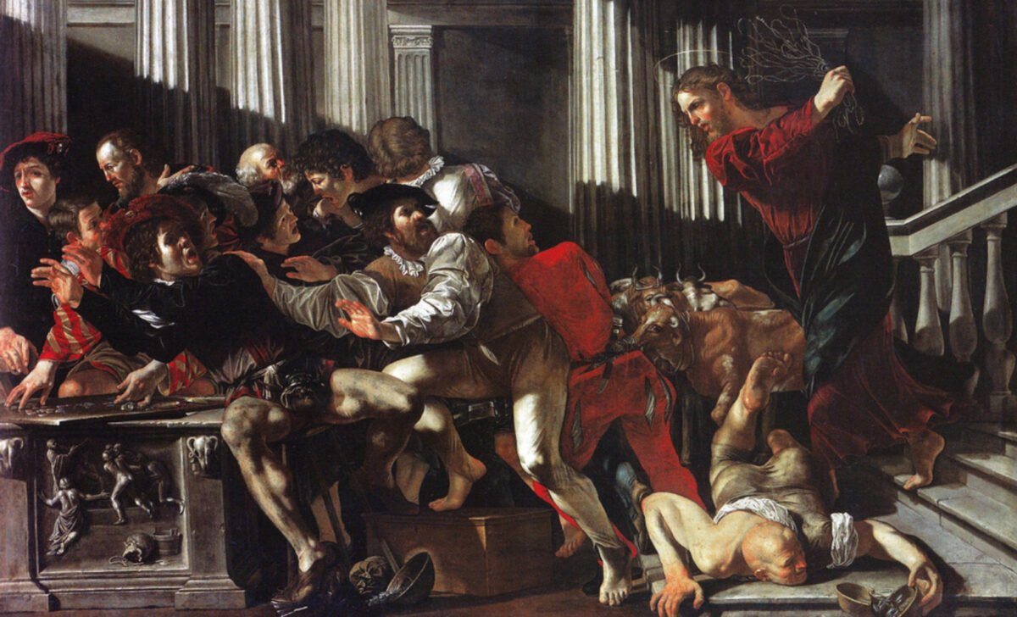
Is Jesus Violent?
Jesus’s Temple Scene in John 2:13-22

Slide 2
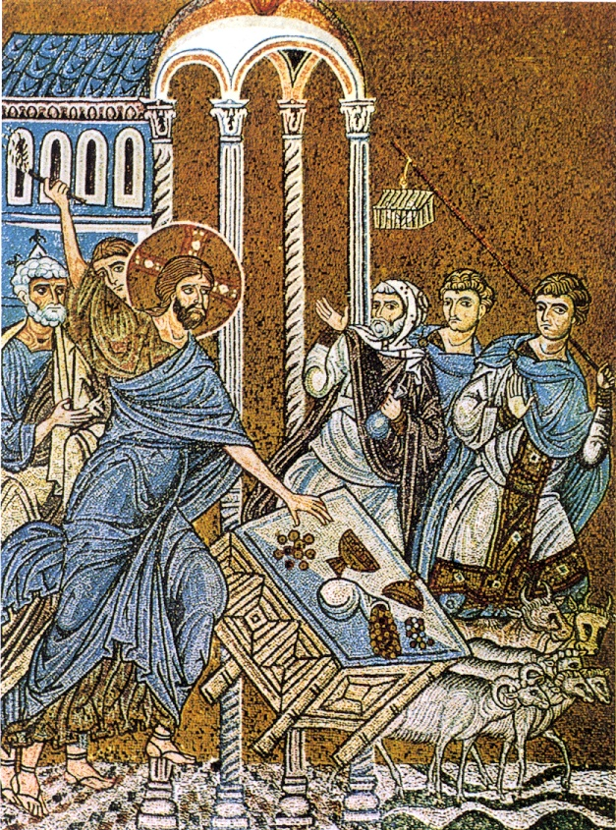
John 2:13-22 (NRSV)
¹³ The Passover of the Jews was near, and Jesus went up to Jerusalem. ¹⁴ In the temple he found people selling cattle, sheep, and doves and the money changers seated at their tables. ¹⁵ Making a whip of cords, he drove all of them out of the temple, with the sheep and the cattle. He also poured out the coins of the money changers and overturned their tables. ¹⁶ He told those who were selling the doves, “Take these things out of here! Stop making my Father’s house a marketplace!” ¹⁷ His disciples remembered that it was written, “Zeal for your house will consume me.” ¹⁸ The Jews then said to him, “What sign can you show us for doing this?” ¹⁹ Jesus answered them, “Destroy this temple, and in three days I will raise it up.” ²⁰ The Jews then said, “This temple has been under construction for forty-six years, and will you raise it up in three days?” ²¹ But he was speaking of the temple of his body. ²² After he was raised from the dead, his disciples remembered that he had said this, and they believed the scripture and the word that Jesus had spoken.

Slide 3
How is John’s Version Different?
Appears at the beginning of the Gospel (not right before his death)
Just after Jesus’s first “sign” in Cana → Water to Wine
Different Old Testament connection (Psalm 69)
A more intense Jesus:
Makes his own whip!
Who does he chase?
So, what does this mean?

Slide 4
Clash of Holy and Profane
Holiness—life-giving and dangerous
Need to be “pure” to approach safely and ensure sacred is not profaned
Mary Douglas on Exod 19:21-22
“The danger is two-edged: the people might break through or the Lord might break out, and in either case, people will die. This is the effect of holiness. The holy thing that is not correctly guarded and fenced will break out and kill, and the impure person not correctly prepared for contact with the holy will be killed.”

Slide 5
Clash of Holy and Profane
Holiness—life-giving and dangerous
Need to be “pure” to approach safely and ensure sacred is not profaned
Common expectation for Jews and Gentiles:
G/gods would protect their sacred places (and people)
Priests were supposed to distinguish sacred from profane and were able to purify the impure

Slide 6
Heliodorus in the Temple (2 Macc 3)
Heliodorus sent by a wicked king to “inspect” (rob) the temple:
People kept their money in temples because they were safe(-ish)
The high priest tells Heliodorus: “it was utterly impossible that wrong should be done to those people who had trusted in the holiness of the place and in the sanctity and inviolability of the temple that is honored throughout the world” (3:12).

Slide 7
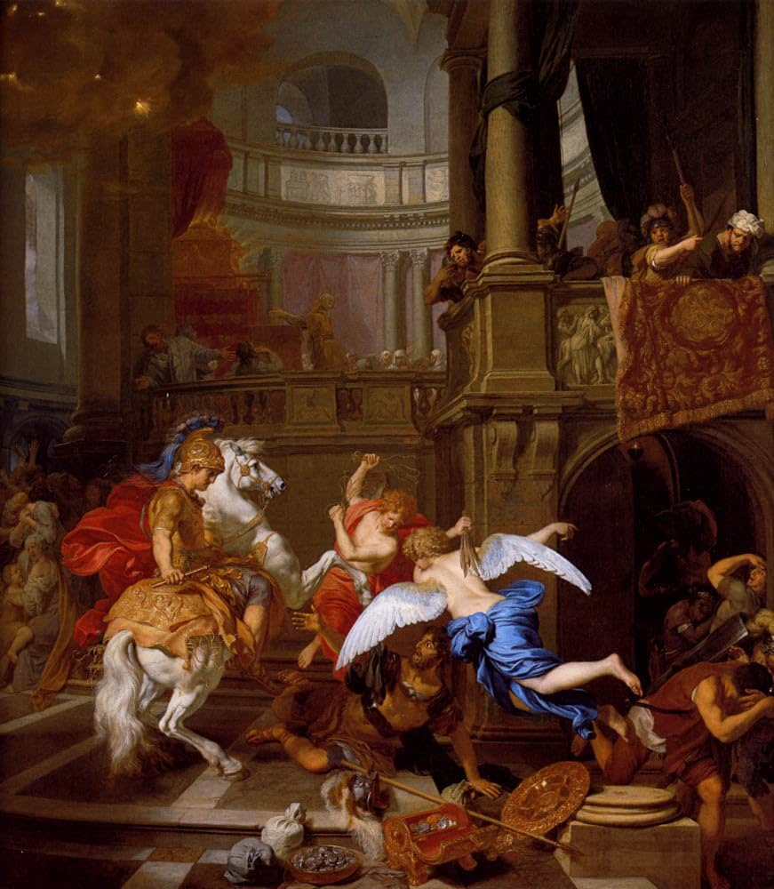
Heliodorus in the Temple (2 Macc 3)
²⁴ But when he arrived at the treasury with his bodyguard, then and there the Sovereign of spirits and of all authority caused so great a manifestation that all who had been so bold as to accompany him were astounded by the power of God and became faint with terror. ²⁵ For there appeared to them a magnificently adorned horse, with a rider of frightening appearance; it rushed furiously at Heliodorus and struck at him with its front hoofs. Its rider was seen to have armor and weapons of gold. ²⁶ Two young men also appeared to him, remarkably strong, gloriously beautiful and splendidly dressed, who stood on either side of him and flogged him continuously, inflicting many blows on him. ²⁷ When he suddenly fell to the ground and deep darkness came over him, his men took him up, put him on a stretcher, ²⁸ and carried him away—this man who had just entered the aforesaid treasury with a great retinue and all his bodyguard but was now unable to help himself with all his weapons. He recognized clearly the sovereign power of God.

Slide 8
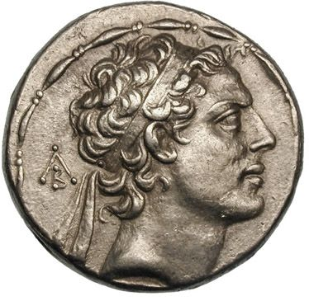
So, How Can the Temple ever be Violated?
Yes...
When the high priest Menelaus leads Antiochus into the temple and he robs it later on in 2 Macc 5.
How can this be?!

Slide 9
So, How Can the Temple ever be Violated?
But if it had not happened that they were involved in many sins, this man would have been flogged and turned back from his rash act as soon as he came forward, just as Heliodorus had been, whom King Seleucus sent to inspect the treasury. ¹⁹ But the Lord did not choose the nation for the sake of the holy place but the place for the sake of the nation. ²⁰ Therefore the place itself shared in the misfortunes that befell the nation and afterward participated in its benefits, and what was forsaken in the wrath of the Almighty was restored again in all its glory when the great Lord became reconciled. (2 Macc 5:18-20)

Slide 10
Clash of Holy and Profane
Holiness—life-giving and dangerous
Need to be “pure” to approach safely and ensure sacred is not profaned
Common expectation for Jews and Gentiles
Desecration (or mixing sacred and profane) results:
Dangerous breaking out (Heliodorus)
Departure or withdraw for a time (Antiochus)

Slide 11
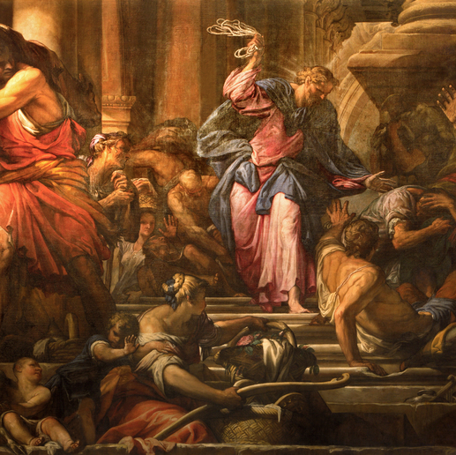
What about John 2:13-22?
Jesus’s entrance into the temple isn’t just an ordinary entrance:
God’s glory in the flesh (1:14-16)
Contrasts his rather quiet sign in 2:1-11 (that also revealed his glory)
He told those who were selling the doves, “Take these things out of here! Stop making my Father’s house a marketplace!” (v. 17)
Clash of Holy and Profane

Slide 12
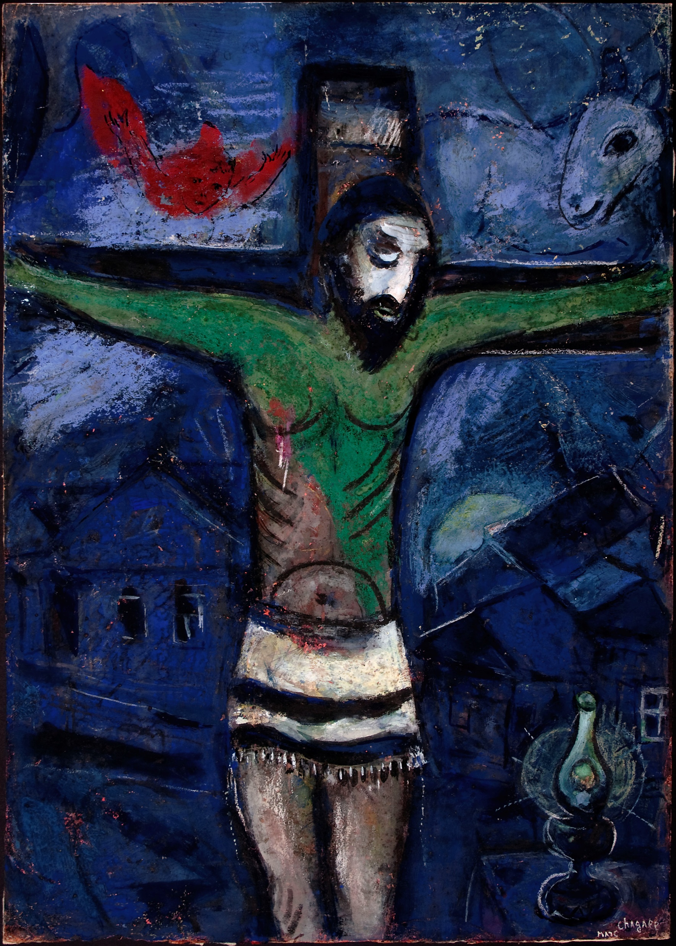
But wait!
If 2:13-17 play into this expectation
2:19-21 undercuts them:
¹⁹ Jesus answered them, “Destroy this sanctuary, and in three days I will raise it up.” ²⁰ The Jews then said, “This sanctuary has been under construction for forty-six years, and will you raise it up in three days?” ²¹ But he was speaking of the sanctuary of his body.
Jesus shifts the violence from the people and the place to receive it himself

Slide 13
So, is Jesus Violent?
Yes and No
Yes—as a demonstration of his identity as the Holy One of God
Jesus’s revelation meets people where they are at!
And shows how bad the problem is...
No—because Jesus’s death and resurrection shifts the expectations.
Jesus doesn’t destroy the temple; he accepts the violence against himself
In this way, John shows that although Jesus has the authority to judge, he repeatedly refuses to do so in order to reveal that his kingdom is “not of this world” (18:36). Instead of mimicking the world’s violence, Jesus conquers it through his death and resurrection that unleash God’s life-giving holiness for all who come to him.

